Slide 1
EECS 490 – Lecture 14 Formal Type Systems

Slide 2
Announcements
Project 3 due Friday 10/27 at 8pm
Midterm Tuesday 10/31 during class time
Will be in 1109 FXB, not in this room
Covers lectures 1-12
You are allowed one 8.5x11" note sheet, double sided
Review session: Sunday 10/29 2-4pm in 1690 BBB
Read §4.1 in the notes before Thursday's lecture

Slide 3
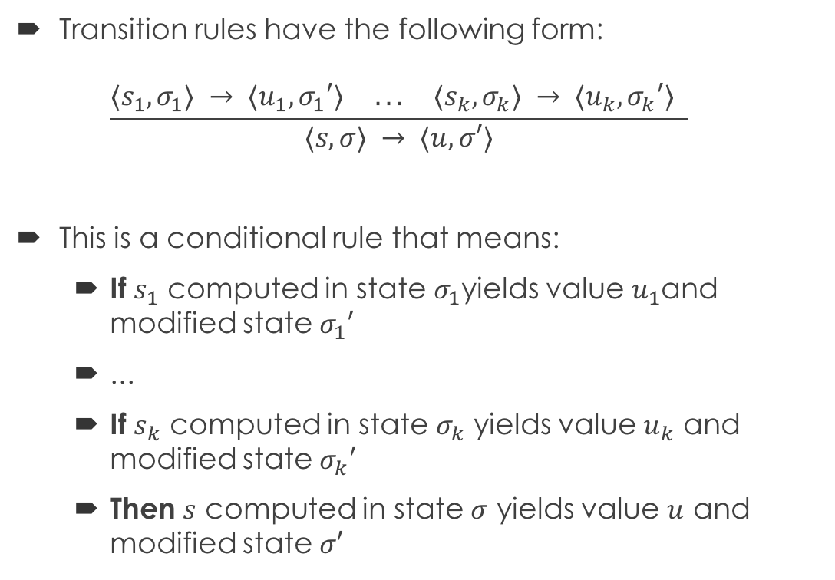
Review: Operational Semantics
Transition rules have the following form: $\frac{⟨s_{1},σ_{1}⟩ → ⟨u_{1},σ_{1}′⟩ ... ⟨s_{k},σ_{k}⟩ → ⟨u_{k},σ_{k}′⟩ }{⟨s,σ⟩ → ⟨u,σ′⟩}$
This is a conditional rule that means:
If $s_{1}$ computed in state $σ_{1}$yields value $u_{1}$and modified state $σ_{1}′$
...
If $s_{k}$ computed in state $σ_{k}$ yields value $u_{k}$ and modified state $σ_{k}′$
Then $s$ computed in state $σ$ yields value $u$ and modified state $σ′$
Premise
Conclusion
Transition

Slide 4
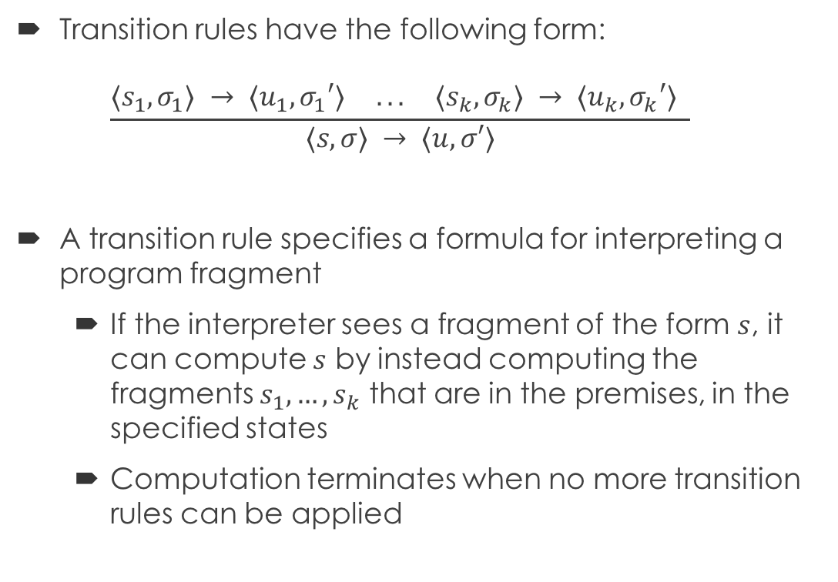
Review: Interpretation
Transition rules have the following form: $\frac{⟨s_{1},σ_{1}⟩ → ⟨u_{1},σ_{1}′⟩ ... ⟨s_{k},σ_{k}⟩ → ⟨u_{k},σ_{k}′⟩ }{⟨s,σ⟩ → ⟨u,σ′⟩}$
A transition rule specifies a formula for interpreting a program fragment
If the interpreter sees a fragment of the form $s$, it can compute $s$ by instead computing the fragments $s_{1},…,s_{k}$ that are in the premises, in the specified states
Computation terminates when no more transition rules can be applied

Slide 5
Type Systems
Types play an important role in programming languages
Signify what data bits actually represent
Determine what operations are valid on a piece of data
Determine how to perform a particular operation
In statically typed languages, the compiler computes types for each expression and checks that the types are used appropriately
A type system specifies a method for computing types based on the syntactic structure of a program

Slide 6
Language
We will use a simple language of numbers and booleans: P → E E → N | B | (E + E) | (E − E) | (E * E) | (E <= E) | (E and E) | not E | (if E then E else E)
Booleans
B → true | false N → IntegerLiteral
Expressions
Numbers

Slide 7
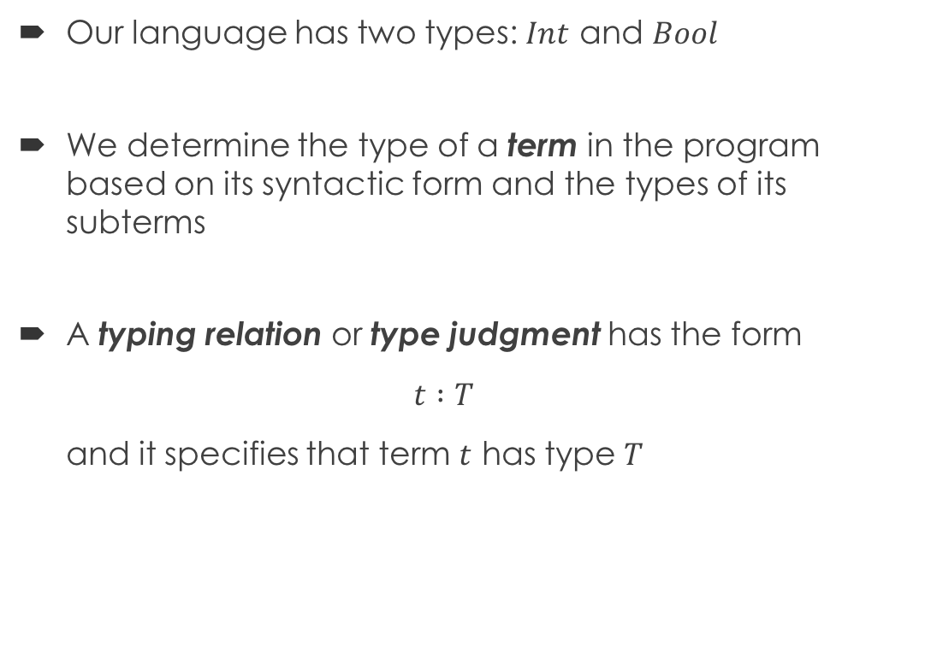
Types and Type Judgments
Our language has two types: $Int$ and $Bool$
We determine the type of a term in the program based on its syntactic form and the types of its subterms
A typing relation or type judgment has the form $t :T$ and it specifies that term $t$ has type $T$

Slide 8
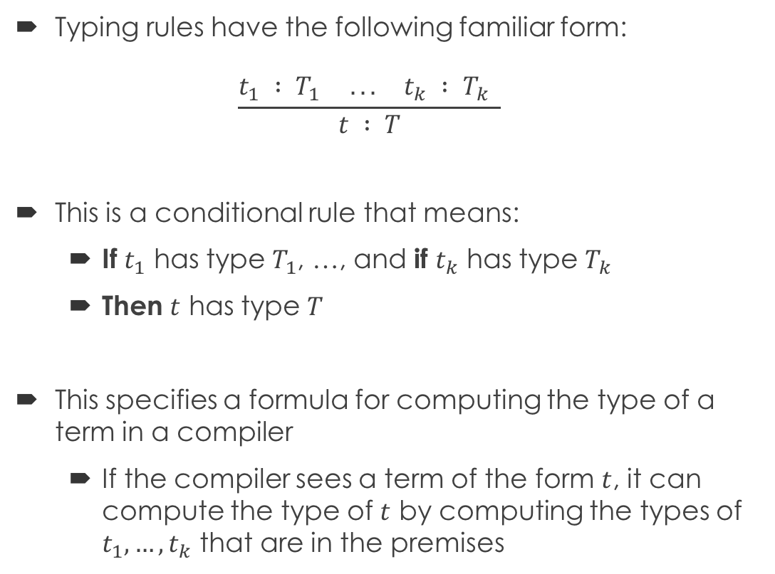
Typing Rule
Typing rules have the following familiar form: $\frac{t_{1} : T_{1} ... t_{k} : T_{k} }{t : T}$
This is a conditional rule that means:
If $t_{1}$ has type $T_{1}$, …, and if $t_{k}$ has type $T_{k}$
Then $t$ has type $T$
This specifies a formula for computing the type of a term in a compiler
If the compiler sees a term of the form $t$, it can compute the type of $t$ by computing the types of $t_{1},…,t_{k}$ that are in the premises
Premise
Conclusion
Type Judgment

Slide 9

Axioms
Literals can be typed directly with no premises: $\frac{ }{\begin{aligned}IntegerLiteral : Int \\ \end{aligned}}$ $\frac{ }{true : Bool}$ $\frac{ }{false : Bool}$

Slide 10
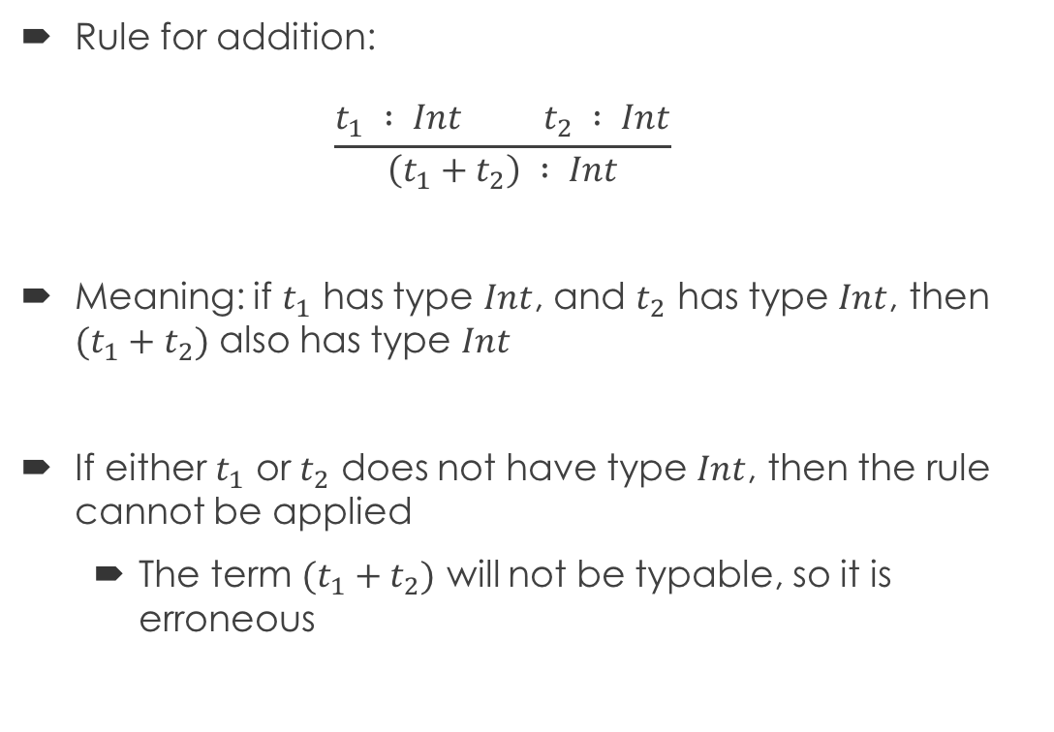
Addition
Rule for addition: $\frac{t_{1} : Int t_{2} : Int}{\left(t_{1}+t_{2}\right) : Int}$
Meaning: if $t_{1}$ has type $Int$, and $t_{2}$ has type $Int$, then ${(t}_{1} + t_{2})$ also has type $Int$
If either $t_{1}$ or $t_{2}$ does not have type $Int$, then the rule cannot be applied
The term ${(t}_{1} + t_{2})$ will not be typable, so it is erroneous

Slide 11

Type Derivations
Typing rules lead to derivation trees, as in operational semantics $\frac{\frac{ }{1 : Int} \frac{\frac{ }{2 : Int} \frac{ }{3 : Int}}{(2+3) : Int}}{\left(1+(2+3)\right) : Int}$

Slide 12
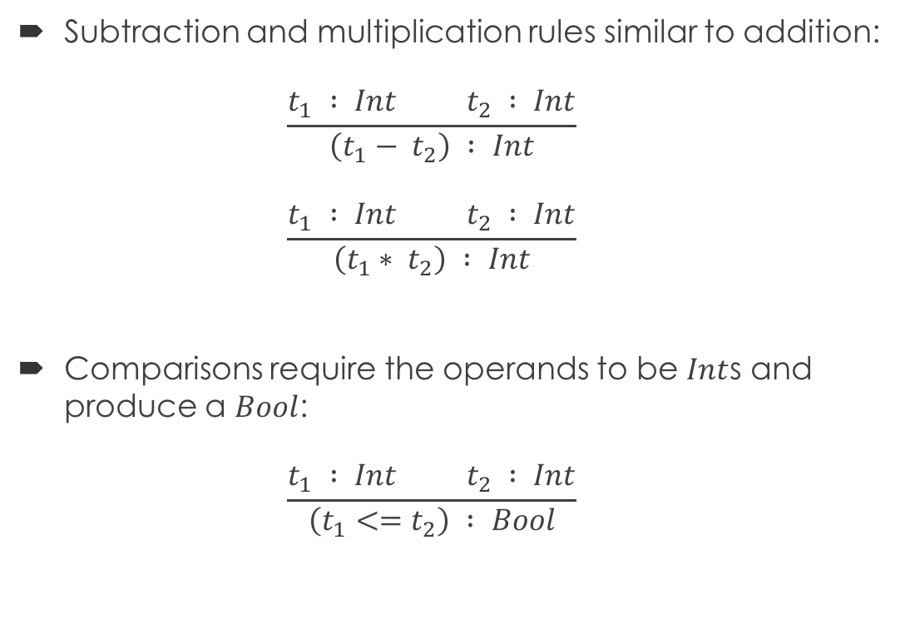
Arithmetic and Comparisons
Subtraction and multiplication rules similar to addition: $\frac{t_{1} : Int t_{2} : Int}{\left(t_{1}− t_{2}\right) : Int}$ $\frac{t_{1} : Int t_{2} : Int}{\left(t_{1}∗ t_{2}\right) : Int}$
Comparisons require the operands to be $Int$s and produce a $Bool$: $\frac{t_{1} : Int t_{2} : Int}{\left(t_{1}<=t_{2}\right) : Bool}$

Slide 13

Conjunction and Negation
Conjunction and negation require the operands to be $Bool$s, produce a $Bool$ as the result $\frac{t_{1} : Bool t_{2} : Bool}{\left(t_{1} and t_{2}\right) : Bool}$ $\frac{t : Bool}{not t : Bool}$

Slide 14
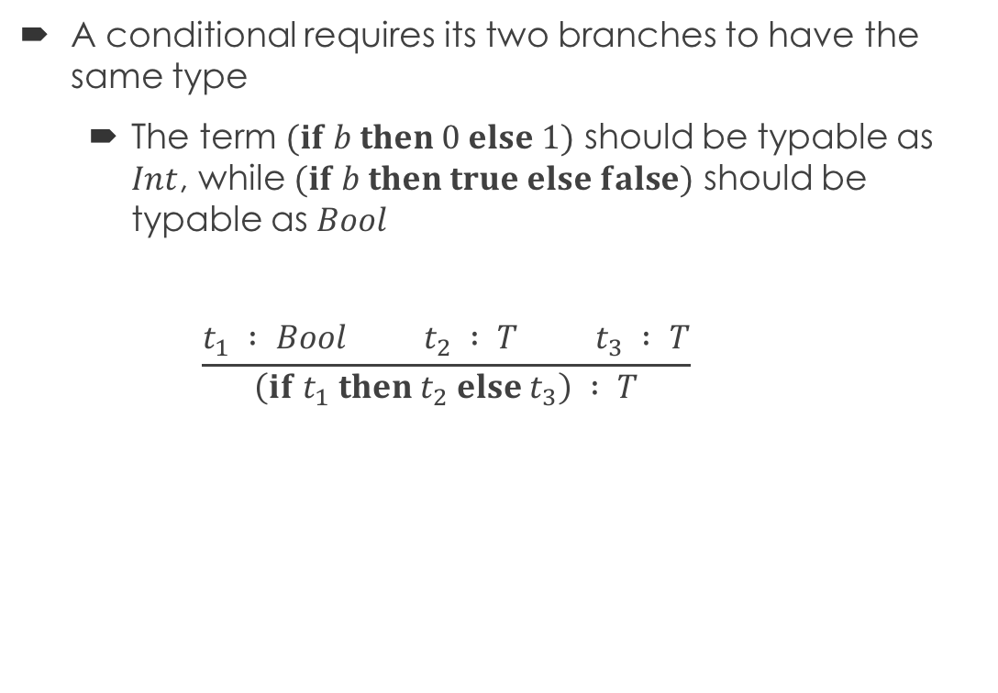
Conditionals
A conditional requires its two branches to have the same type
The term $(if b then 0 else 1)$ should be typable as $Int$, while $(if b then true else false)$ should be typable as $Bool$ $\frac{t_{1} : Bool t_{2} : T t_{3} : T}{\left(if t_{1} then t_{2} else t_{3}\right) : T}$
Type variable can be any type

Slide 15
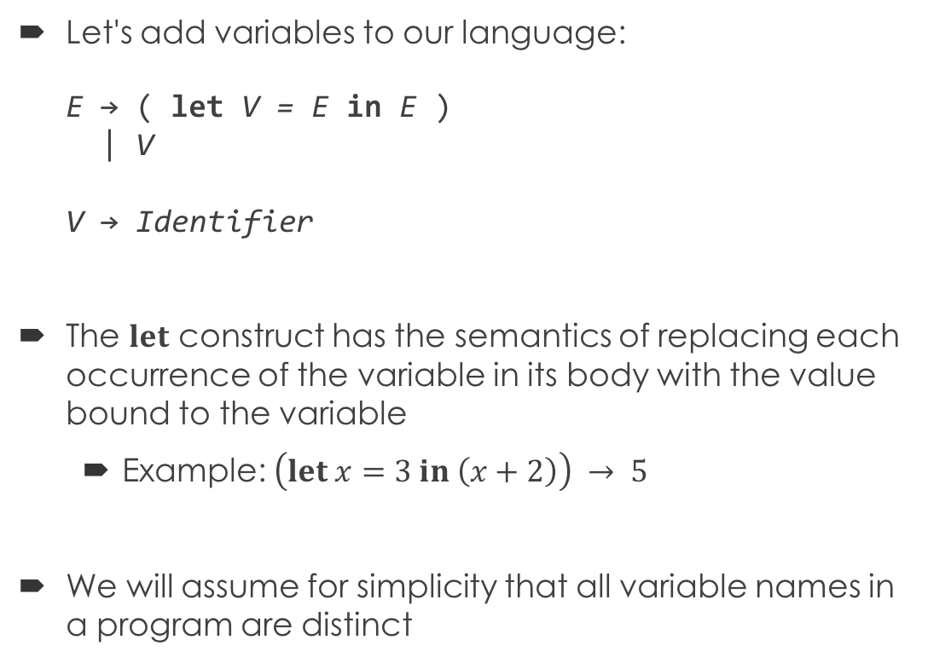
Variables
Let's add variables to our language: E → ( let V = E in E ) | V V → Identifier
The $let$ construct has the semantics of replacing each occurrence of the variable in its body with the value bound to the variable
Example: $\left(let x=3 in \left(x+2\right)\right) → 5$
We will assume for simplicity that all variable names in a program are distinct

Slide 16
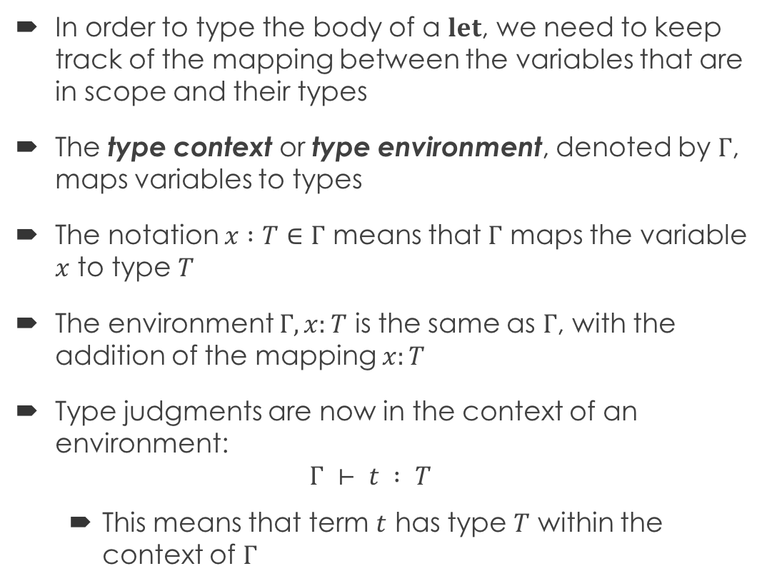
Type Environments
In order to type the body of a $let$, we need to keep track of the mapping between the variables that are in scope and their types
The type context or type environment, denoted by $Γ$, maps variables to types
The notation $x :T∈Γ$ means that $Γ$ maps the variable $x$ to type $T$
The environment $Γ,x:T$ is the same as $Γ$, with the addition of the mapping $x:T$
Type judgments are now in the context of an environment: $Γ ⊢ t : T$
This means that term $t$ has type $T$ within the context of $Γ$

Slide 17
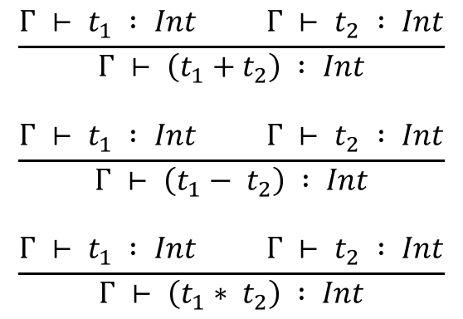
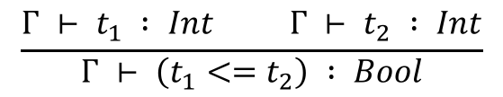
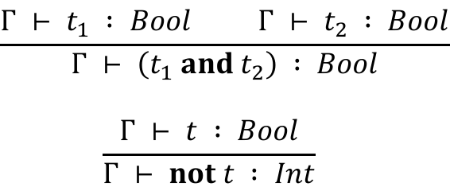
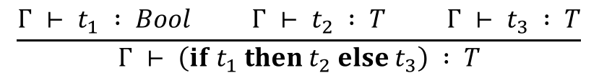
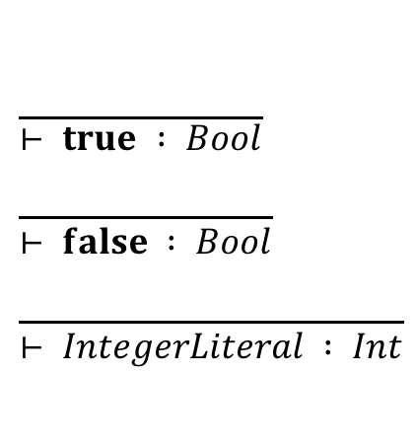
Rules with Type Environments
$$\frac{ }{\begin{aligned}⊢ true : Bool \\ \end{aligned}} \\ \frac{ }{⊢ false : Bool} \\ \frac{ }{⊢ IntegerLiteral : Int}$$
$$\frac{{Γ ⊢ t}_{1} : Bool {Γ ⊢ t}_{2} : T {Γ ⊢ t}_{3} : T}{Γ ⊢ \left(if t_{1} then t_{2} else t_{3}\right) : T}$$
True in any context, so context is elided
$$\frac{{Γ ⊢ t}_{1} : Bool {Γ ⊢ t}_{2} : Bool}{Γ ⊢ \left(t_{1} and t_{2}\right) : Bool} \\ \frac{Γ ⊢ t : Bool}{Γ ⊢ not t : Int}$$
$$\frac{{Γ ⊢ t}_{1} : Int {Γ ⊢ t}_{2} : Int}{Γ ⊢ \left(t_{1}+t_{2}\right) : Int}$$
$$\frac{{Γ ⊢ t}_{1} : Int {Γ ⊢ t}_{2} : Int}{Γ ⊢ \left(t_{1}− t_{2}\right) : Int} \\ \frac{{Γ ⊢ t}_{1} : Int {Γ ⊢ t}_{2} : Int}{Γ ⊢ \left(t_{1}∗ t_{2}\right) : Int}$$
$$\frac{{Γ ⊢ t}_{1} : Int {Γ ⊢ t}_{2} : Int}{Γ ⊢ \left(t_{1}<=t_{2}\right) : Bool}$$

Slide 18
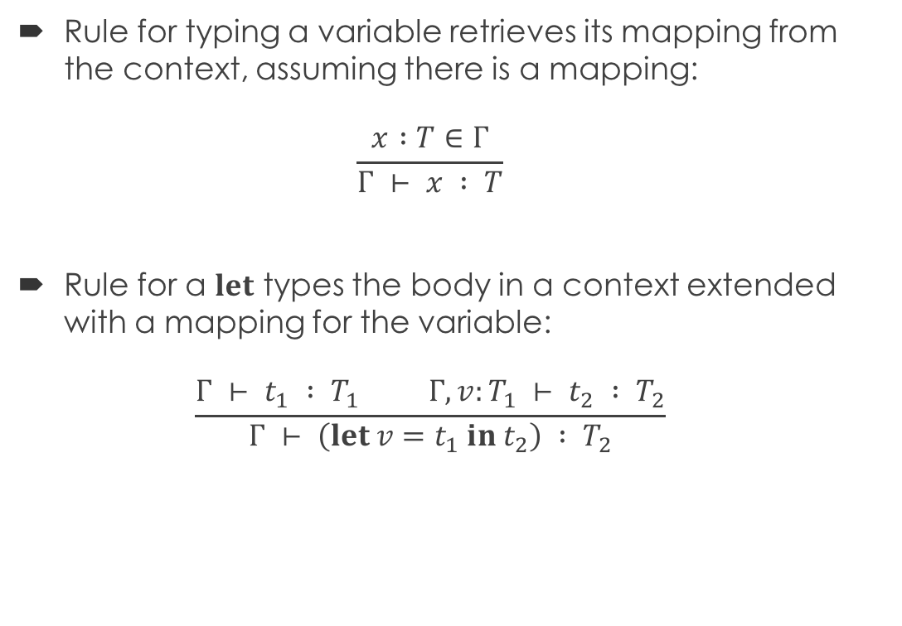
Variable Typing Rule
Rule for typing a variable retrieves its mapping from the context, assuming there is a mapping: $\frac{x :T∈Γ}{Γ ⊢ x : T}$
Rule for a $let$ types the body in a context extended with a mapping for the variable: $\frac{{Γ ⊢ t}_{1} : T_{1} {Γ, v:T_{1} ⊢ t}_{2} : T_{2}}{Γ ⊢ \left(let v=t_{1} in t_{2}\right) : T_{2}}$

Slide 19
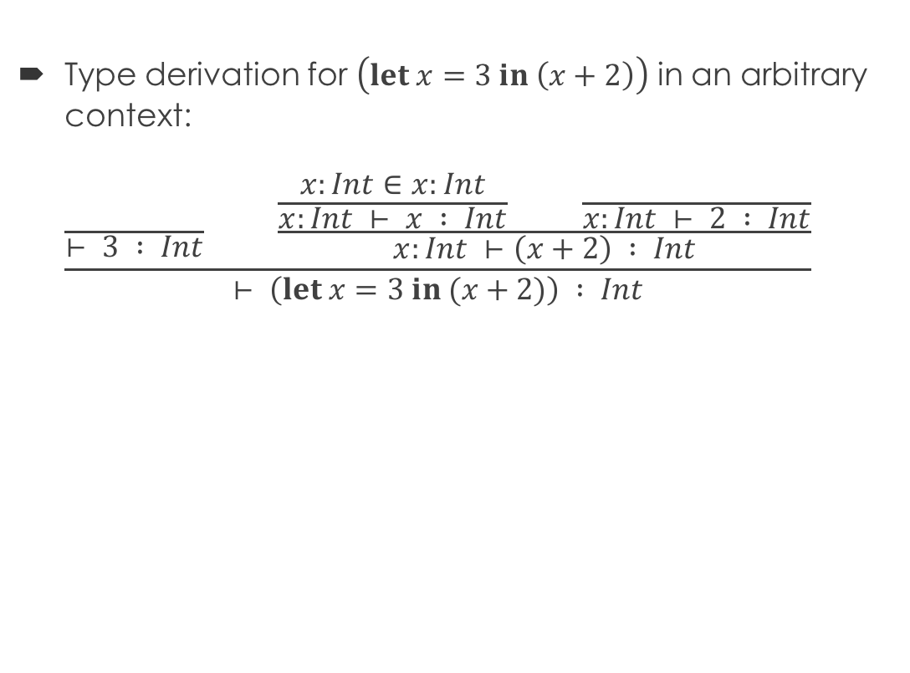
Example
Type derivation for $\left(let x=3 in \left(x+2\right)\right)$ in an arbitrary context: $\frac{\frac{ }{⊢ 3 : Int} \frac{\frac{x:Int∈x:Int}{x:Int ⊢ x : Int} \frac{ }{x:Int ⊢ 2 : Int}}{x:Int ⊢\left(x+2\right) : Int}}{⊢ \left(let x=3 in (x+2)\right) : Int}$

Slide 20
Break Time!
We'll start again in five minutes.

Slide 21
Functions
Let's now add functions that take in a single argument: E → ( lambda V : T . E ) | ( E E )
Function parameters are explicitly typed, so we need to add types to our grammar: T → Int | Bool | T → T | ( T )
Abstraction
Application
Function type

Slide 22
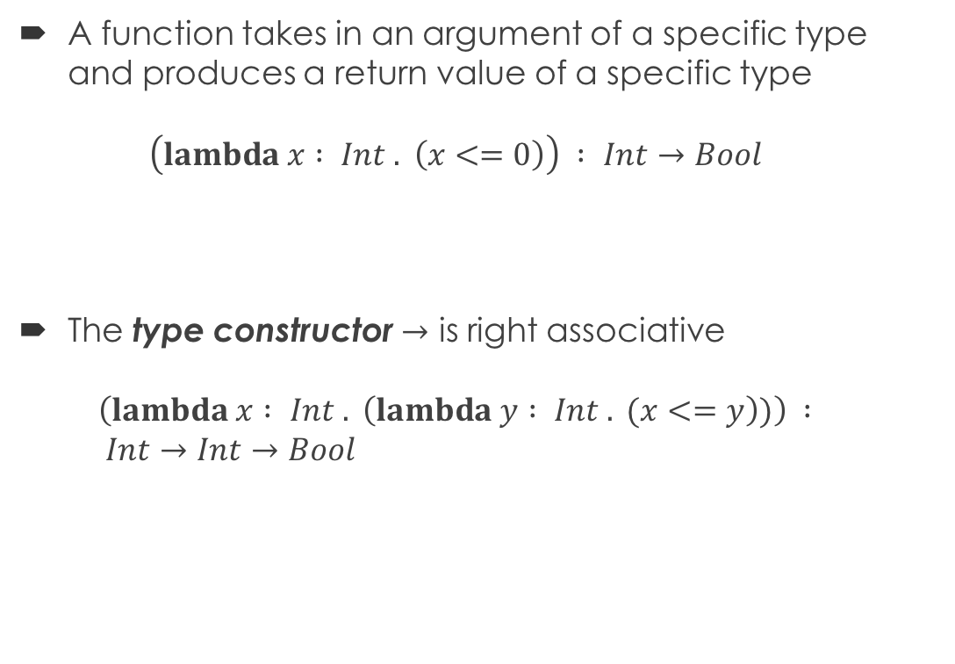
Function Types
A function takes in an argument of a specific type and produces a return value of a specific type $\left(lambda x : Int . \left(x<=0\right)\right) : Int→Bool$
The type constructor $→$ is right associative $\left(lambda x : Int . \left(lambda y : Int . (x<=y\right))\right) :$ $Int→Int→Bool$
Parameter type
Return type
Parameter type
Return type

Slide 23
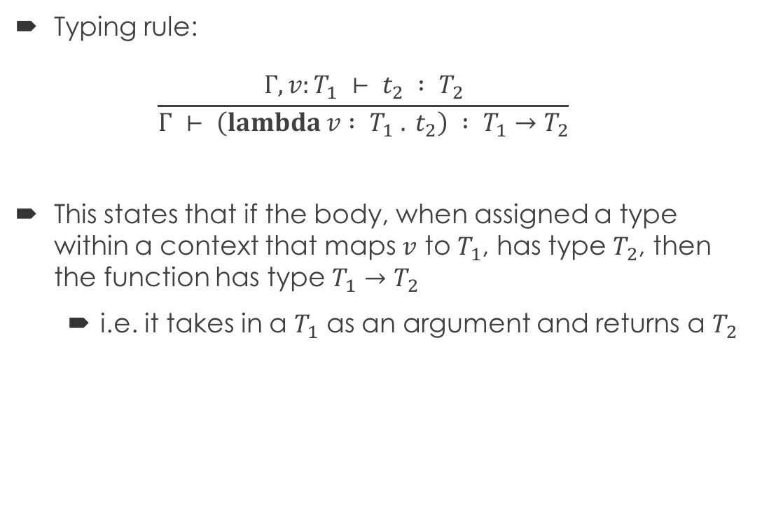
Function Abstraction
Typing rule: $\frac{{Γ, v:T_{1} ⊢ t}_{2} : T_{2}}{Γ ⊢ \left(lambda v : T_{1} . t_{2}\right) : T_{1}→T_{2}}$
This states that if the body, when assigned a type within a context that maps $v$ to $T_{1}$, has type $T_{2}$, then the function has type $T_{1}→T_{2}$
i.e. it takes in a $T_{1}$ as an argument and returns a $T_{2}$

Slide 24
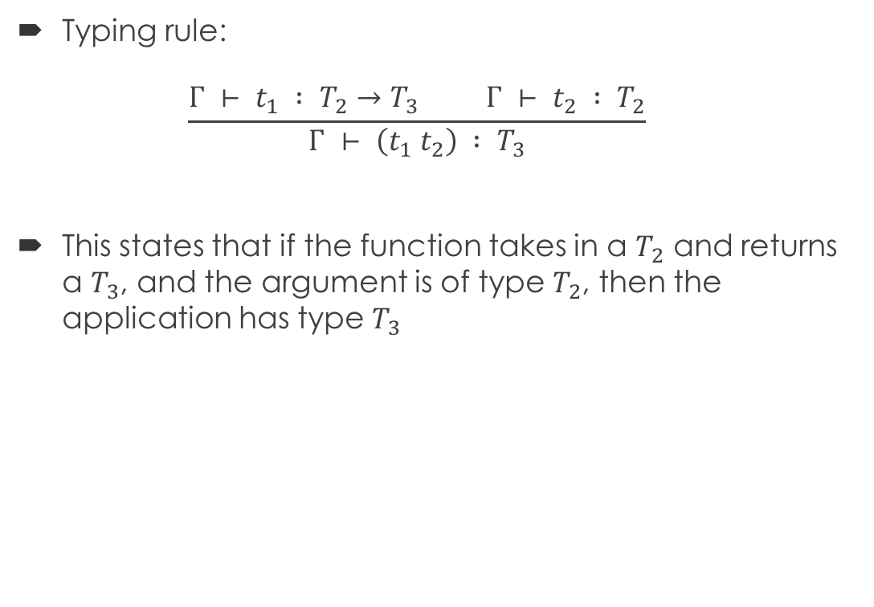
Function Application
Typing rule: $\frac{{Γ ⊢ t}_{1} : T_{2}→T_{3} {Γ ⊢ t}_{2} : T_{2}}{Γ ⊢ \left(t_{1} t_{2}\right) : T_{3}}$
This states that if the function takes in a $T_{2}$ and returns a $T_{3}$, and the argument is of type $T_{2}$, then the application has type $T_{3}$

Slide 25
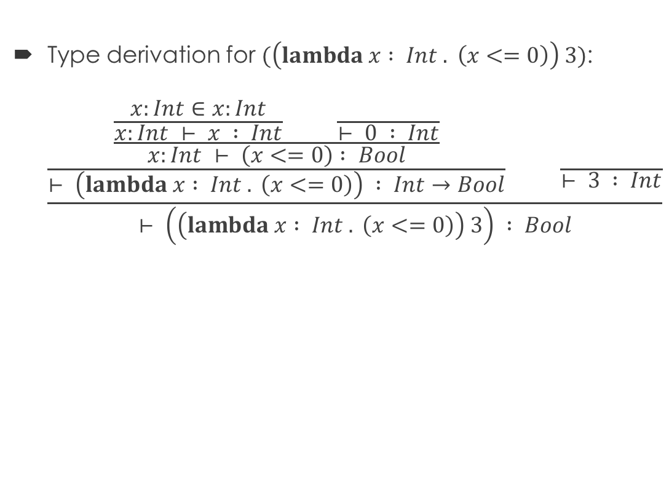
Example
Type derivation for $(\left(lambda x : Int . \left(x<=0\right)\right) 3)$: $\frac{\frac{\frac{\frac{x:Int∈x:Int}{x:Int ⊢ x : Int} \frac{ }{⊢ 0 : Int}}{x:Int ⊢ \left(x<=0\right) : Bool}}{⊢ \left(lambda x : Int . \left(x<=0\right)\right) : Int→Bool} \frac{ }{⊢ 3 : Int}}{⊢ \left(\left(lambda x : Int . \left(x<=0\right)\right) 3\right) : Bool}$

Slide 26
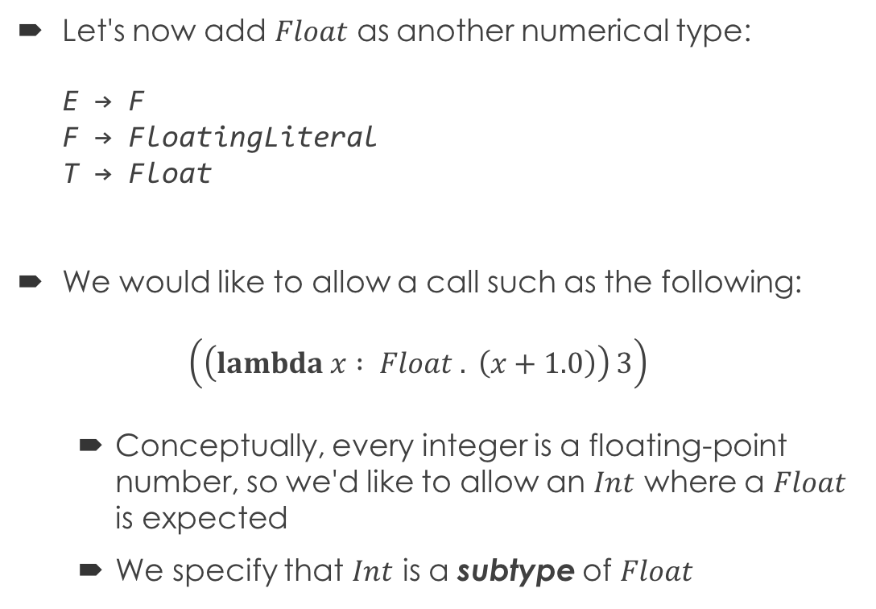
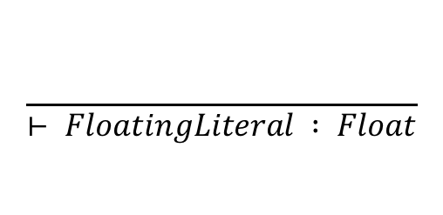
Subtyping
Let's now add $Float$ as another numerical type: E → F F → FloatingLiteral T → Float
We would like to allow a call such as the following: $\left(\left(lambda x : Float . \left(x+1.0\right)\right) 3\right)$
Conceptually, every integer is a floating-point number, so we'd like to allow an $Int$ where a $Float$ is expected
We specify that $Int$ is a subtype of $Float$
$$\frac{ }{⊢ FloatingLiteral : Float}$$

Slide 27
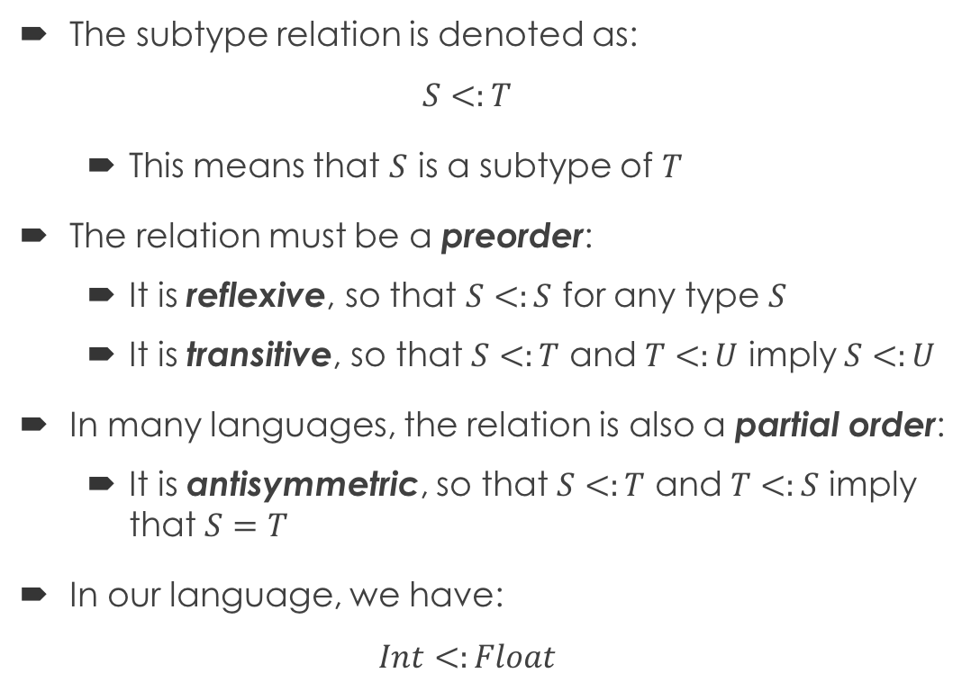
Subtype Relation
The subtype relation is denoted as: $S<:T$
This means that $S$ is a subtype of $T$
The relation must be a preorder:
It is reflexive, so that $S<:S$ for any type $S$
It is transitive, so that $S<:T$ and $T<:U$ imply $S<:U$
In many languages, the relation is also a partial order:
It is antisymmetric, so that $S<:T$ and $T<:S$ imply that $S=T$
In our language, we have: $Int<:Float$

Slide 28
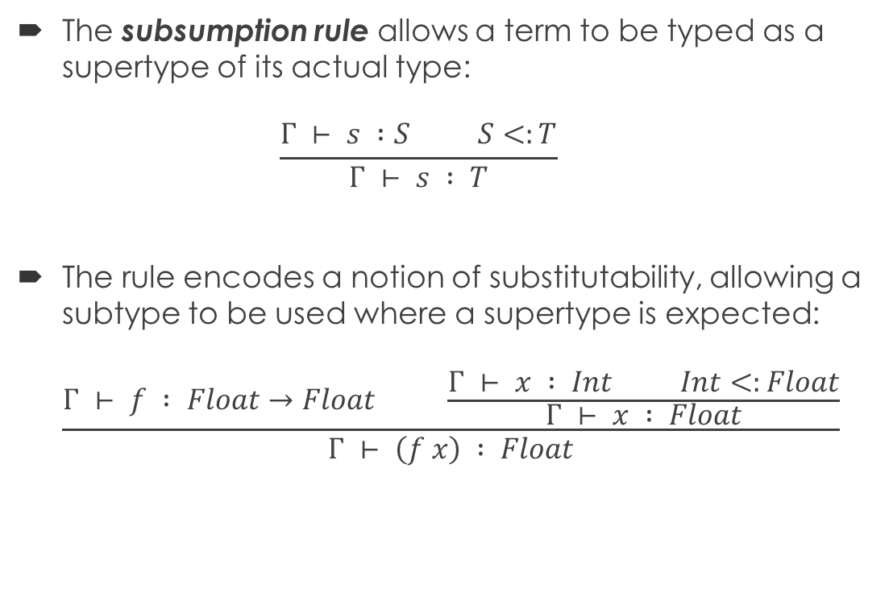
Subsumption Rule
The subsumption rule allows a term to be typed as a supertype of its actual type: $\frac{Γ ⊢ s :S S<:T}{Γ ⊢ s : T}$
The rule encodes a notion of substitutability, allowing a subtype to be used where a supertype is expected: $\frac{Γ ⊢ f : Float→Float \frac{Γ ⊢ x : Int Int<:Float}{Γ ⊢ x : Float}}{Γ ⊢ \left(f x\right) : Float}$

Slide 29
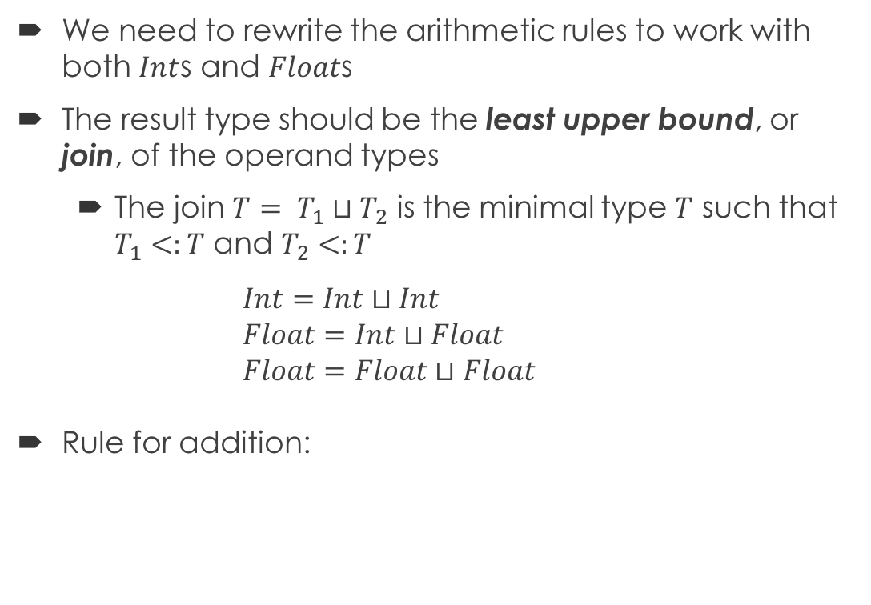
Joins
We need to rewrite the arithmetic rules to work with both $Int$s and $Float$s
The result type should be the least upper bound, or join, of the operand types
The join $T= T_{1}⊔T_{2}$ is the minimal type $T$ such that $T_{1}<:T$ and $T_{2}<:T$ $Int=Int⊔Int$ $Float=Int⊔Float$ $Float=Float⊔Float$
Rule for addition:
Require operand type to be a number
$$\frac{{Γ ⊢ t}_{1} : T_{1} {Γ ⊢ t}_{2} : T_{2} T_{1}<:Float T_{2}<:Float T= T_{1}⊔T_{2}}{Γ ⊢ \left(t_{1}+t_{2}\right) : T}$$

Slide 30
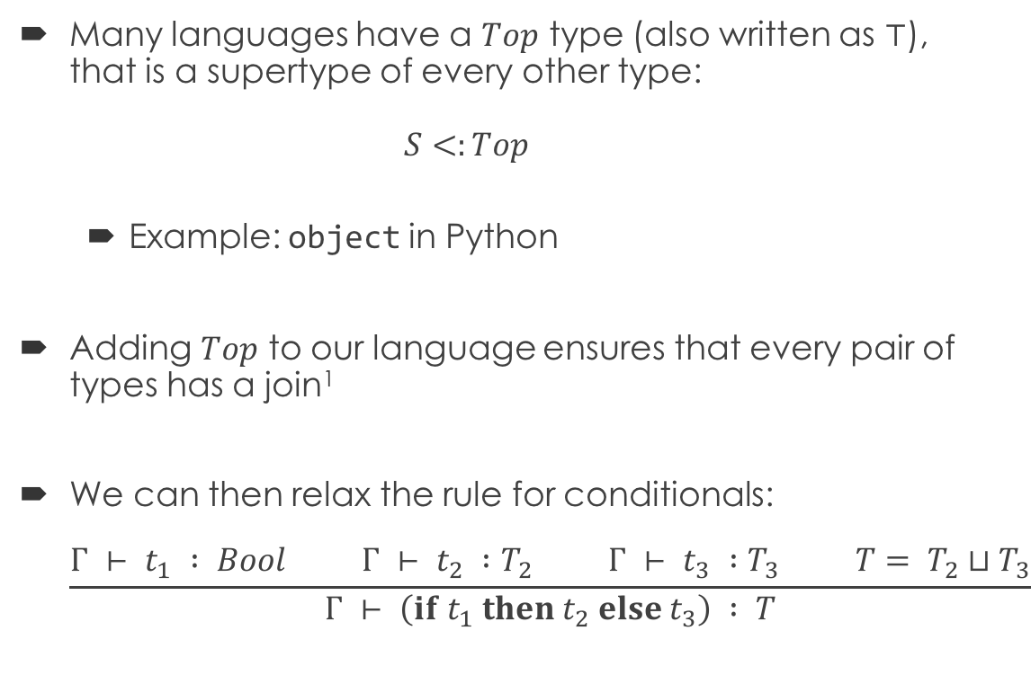
The Top Type
Many languages have a $Top$ type (also written as $⊤$), that is a supertype of every other type: $S<:Top$
Example: object in Python
Adding $Top$ to our language ensures that every pair of types has a join¹
We can then relax the rule for conditionals: $\frac{{Γ ⊢ t}_{1} : Bool {Γ ⊢ t}_{2} :T_{2} {Γ ⊢ t}_{3} :T_{3} T= T_{2}⊔T_{3}}{Γ ⊢ \left(if t_{1} then t_{2} else t_{3}\right) : T}$

Slide 31
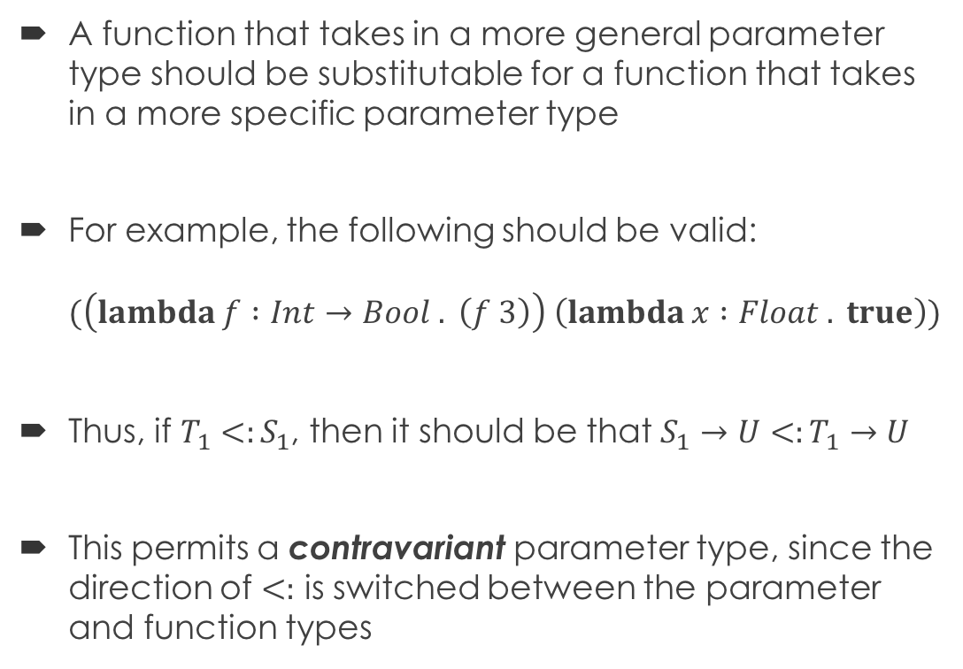
Contravariant Parameters
A function that takes in a more general parameter type should be substitutable for a function that takes in a more specific parameter type
For example, the following should be valid: $(\left(lambda f :Int→Bool . \left(f 3\right)\right) \left(lambda x :Float . true\right))$
Thus, if $T_{1}<:S_{1}$, then it should be that $S_{1}→U<:T_{1}→U$
This permits a contravariant parameter type, since the direction of $<:$ is switched between the parameter and function types

Slide 32
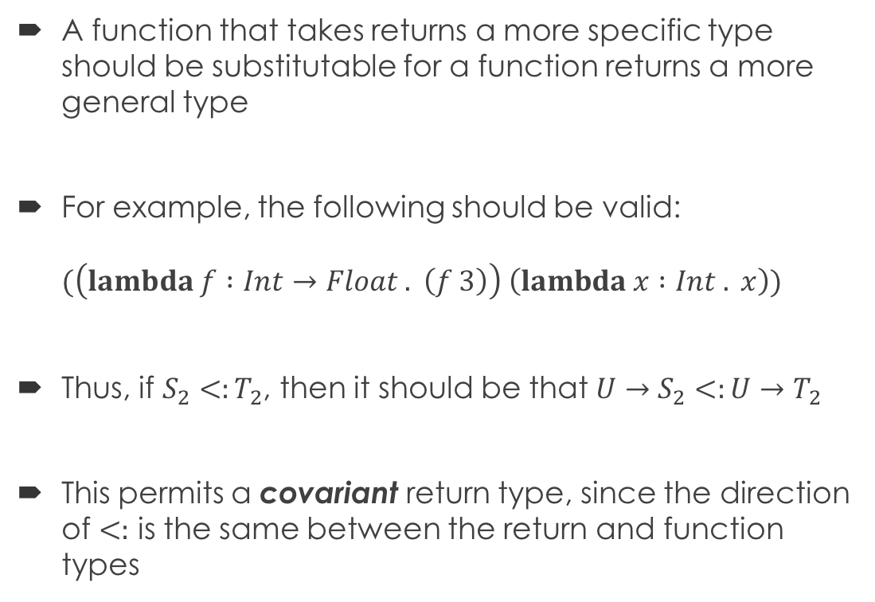
Covariant Return Types
A function that takes returns a more specific type should be substitutable for a function returns a more general type
For example, the following should be valid: $(\left(lambda f :Int→Float . \left(f 3\right)\right) \left(lambda x :Int . x\right))$
Thus, if $S_{2}<:T_{2}$, then it should be that $U→S_{2}<:U→T_{2}$
This permits a covariant return type, since the direction of $<:$ is the same between the return and function types

Slide 33
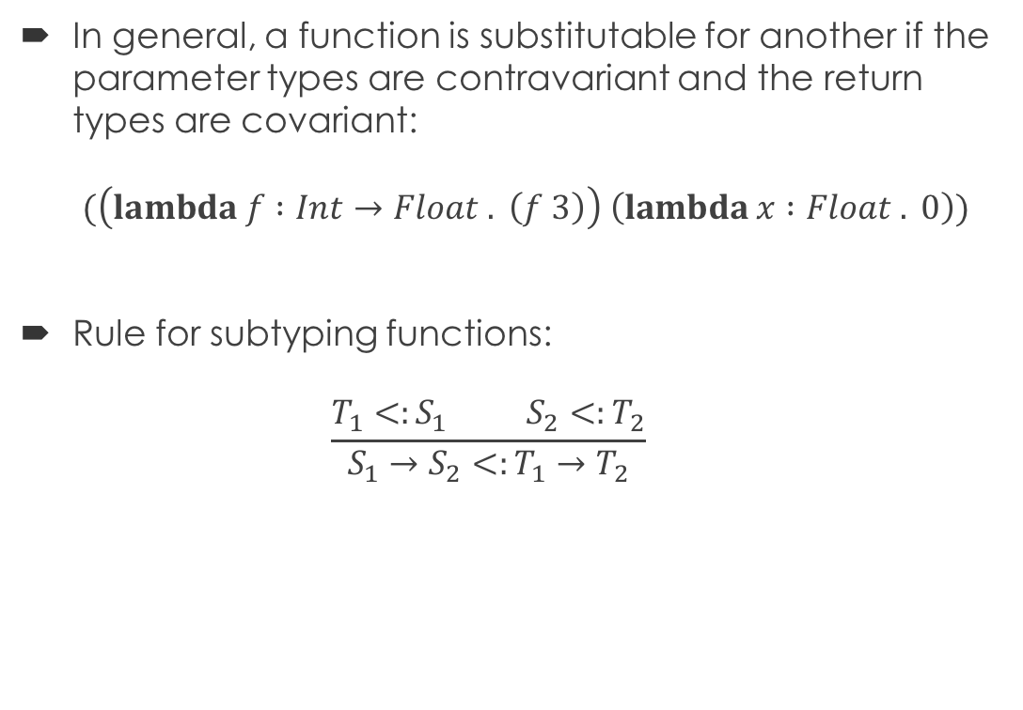
Subtyping for Functions
In general, a function is substitutable for another if the parameter types are contravariant and the return types are covariant: $(\left(lambda f :Int→Float . \left(f 3\right)\right) \left(lambda x :Float . 0\right))$
Rule for subtyping functions: $\frac{T_{1}<:S_{1} S_{2}<:T_{2}}{S_{1}→S_{2}<:T_{1}→T_{2}}$

